Slide 1
Programming with Python (22616)
Unit I-Introduction and Syntax of Python Programming
Sangita B. Chavan
Lecturer, Computer
Government Polytechnic, Ahmednagar

Slide 2
Topics
Introduction and syntax of Python Programming 1.1 Features: Interactive, Object-oriented, Interpreted,Platform independent etc. 1.2 Python building blocks: Identifiers,Keywords, Indentation, Comments, Variables. 1.3 Python environment setup-Installation &working of IDE. 1.3 Running simple Python script to display “Welcome” message. 1.4 Python Data Types: Numbers, String, Tuples, List, Dictionary, Declaration and use of data types

Slide 3
Setting Up Python on Windows
Go to https://www.python.org/downloads/ and get the latest distribution (3.9)
Online tutorials
Python related websites
Use all the defaults when installing

Slide 4
What is Python?
Python is a popular programming language. It was created by Guido van Rossum, and released in 1991.
It is used for:
Python can be used on a server to create web applications.
Python can be used alongside software to create workflows.
Python can connect to database systems. It can also read and modify files.
Python can be used to handle big data and perform complex mathematics.
Python can be used for rapid prototyping, or for production-ready software development.

Slide 5
Why Python?
Python works on different platforms (Windows, Mac, Linux, Raspberry Pi, etc).
Python has a simple syntax similar to the English language.
Python has syntax that allows developers to write programs with fewer lines than some other programming languages.
Python runs on an interpreter system, meaning that code can be executed as soon as it is written. This means that prototyping can be very quick.
Python can be treated in a procedural way, an object-oriented way or a functional way.

Slide 6
Features
Interactive
Object-oriented
Interpreted
Platform independent

Slide 7
Python features
Lutz, Programming Python
no compiling or linking | rapid development cycle
no type declarations | simpler, shorter, more flexible
automatic memory management | garbage collection
high-level data types and operations | fast development
object-oriented programming | code structuring and reuse, C++
embedding and extending in C | mixed language systems
classes, modules, exceptions | "programming-in-the-large" support
dynamic loading of C modules | simplified extensions, smaller binaries
execution speed, protecting source code | programs can be modified without stopping

Slide 8
Your First Python Program
At the prompt (>>>) type:
print “HI”
Press [Enter]
Very straightforward
You could have guessed what this does without knowing Python!

Slide 9
Programming in Script Mode
Interactive mode gives you immediate feedback
Not designed to create programs to save and run later
Script Mode
Write, edit, save, and run (later)
Word processor for your code
Save your file using the “.py” extension

Slide 10
Python Building Blocks
Reserved words (keywords) - words that have pre-defined meanings in the python language
Python Identifiers
A Python identifier is a name used to identify a variable, function, class, module or other object.
An identifier starts with a letter A to Z or a to z or an underscore (_) followed by zero or more letters, underscores and digits (0 to 9).

Slide 11
Python Building Blocks
Literals - literal values written in code, like strings or numbers
4, 4.77, ‘X’, “ABC”
Comment- Comment lines provide documentation about your program
Anything after the “#” symbol is a comment

Slide 12
Creating a Comment:
Comments starts with a #, and Python will ignore them:
Example:-
#This is a comment print("Hello, World!")
Multi Line Comments:
To add a multiline comment you could insert a # for each line:
Example:-
#This is a comment #written in #more than just one line print("Hello, World!")

Slide 13
Multi Line Comments:
Python specially provides a multiline comment facility by using triple quotes,either single(‘ ‘ ‘) or double(“ “ “).
Example:-
‘ ‘ ‘This is a comment written in
more than just one line ‘ ‘ ‘ print("Hello, World!")
OR
Example:-
“ “ “ This is a comment written in
more than just one line “ “ “ print("Hello, World!")

Slide 14
Python Indentation
Indentation refers to the spaces at the beginning of a code line.
Python uses indentation to indicate a block of code.
In python, indentation defines a block. Hence, its most important when working with branching, looping or function statements.

Slide 15
Indentation
Well indented code
Poor indented code
If( a>b && a>c)
Display a
Else if ( b>a && b>c)
Display b
Else
Display c
If( a>b && a>c)
Display a
Else if ( b>a && b>c)
Display b
Else
Display c

Slide 16
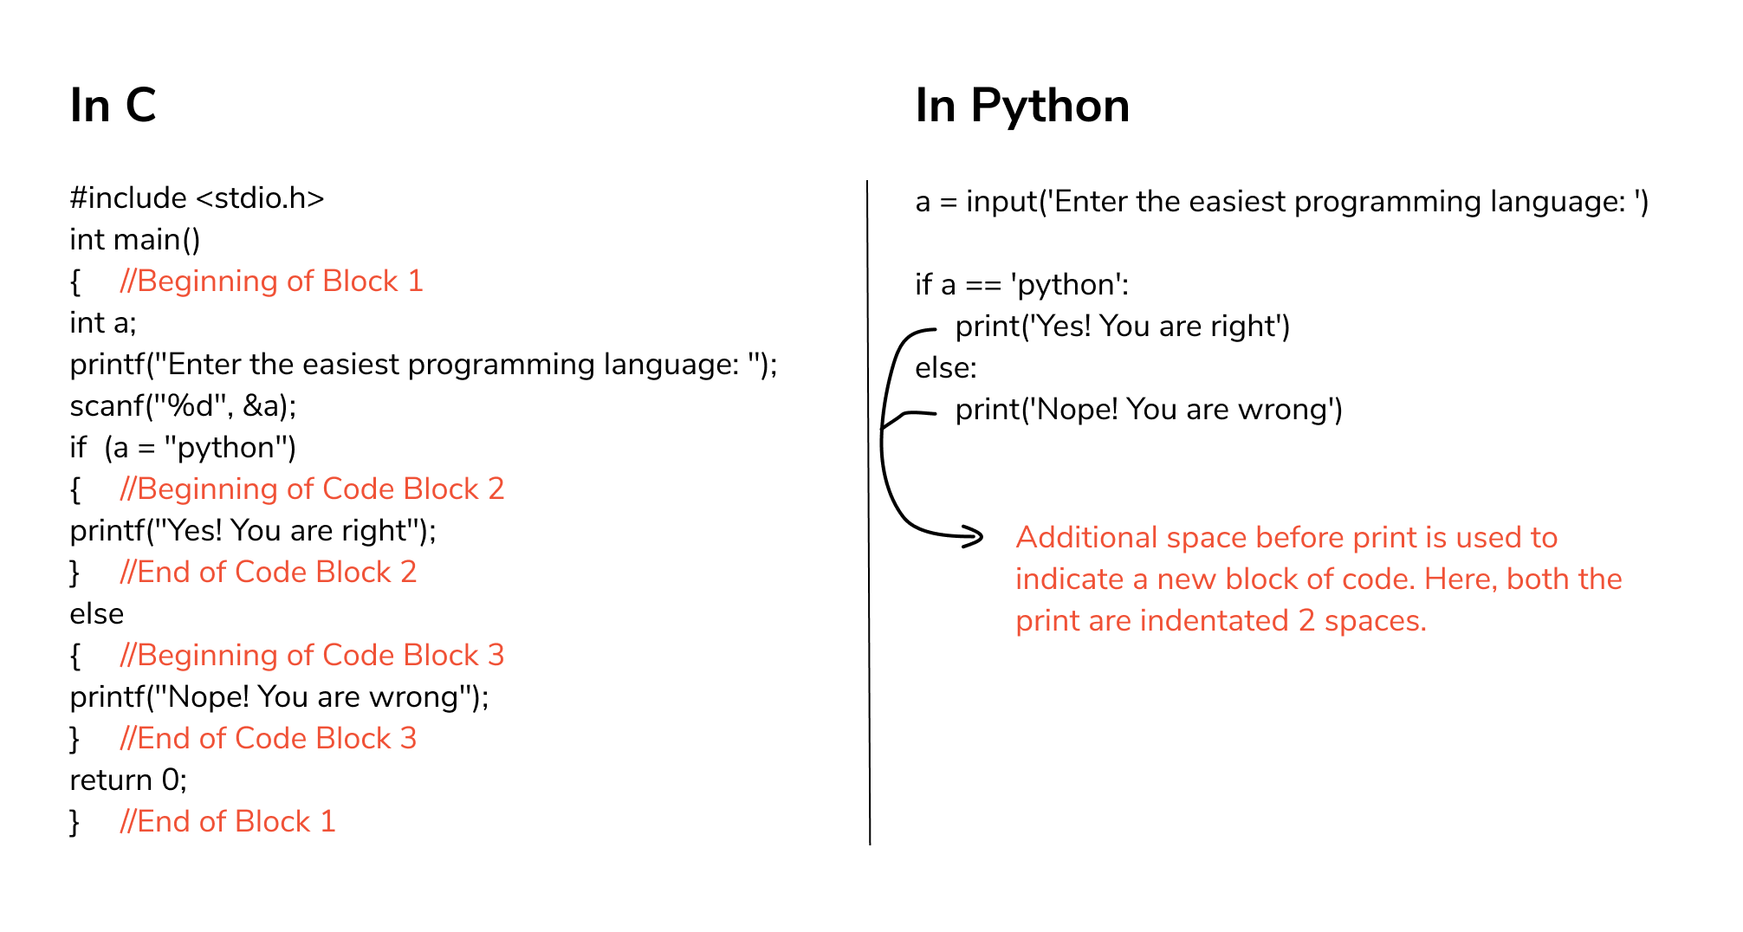

Slide 17
Variables
Variables are containers for storing data values.
Unlike other programming languages, Python has no command for declaring a variable.
A variable is created the moment you first assign a value to it.
Example:-
x = 5 y = "John" print(x) print(y)
Variables do not need to be declared with any particular type, and can even change type after they have been set.
Example
x = 4 x = “tally“ print(x)

Slide 18
Memory allocation
Instead of storing values in the memory space reserved by the variable, Python has the variable refer to the value. Similar to pointers in C, variables in Python refer to values (or objects) stored somewhere in memory.
>>> a=10
10
a
>>> a=20
10
20
>>> b=10
a
b

Slide 19
Variable nomenclature
Rules for Python variables:
A variable name must start with a letter or the underscore character
A variable name cannot start with a number
A variable name can only contain alpha-numeric characters and underscores (A-z, 0-9, and _ )
Variable names are case-sensitive (age, Age and AGE are three different variables)
* Python is case sensitive.

Slide 20
Data Types
boolean - has two possible values, True or False
integer (int) types - for storage of integer values
floating (float) point types - for storage of decimal numbers (i.e. a fractional part after the decimal)
string (str) type: used to store strings in memory.
list - are also referred to as arrays that can contain mixed datatypes.
Dictionary- same as hash table. Includes, key:value pairs.
object - user defined types.
A tuple : a collection of objects which ordered and immutable. Tuples are sequences, just like lists.

Slide 21
